Slide 1

C Programming
Week 06 21.12.04. 07:00 PM
Second-half period / CMD-C_Programming Study
Mentor : Jh9892

Slide 2
INDEX
INDEX
🔥C Language Personal Concept to Pointer
🔥C Language – Structure

Slide 3
Pointer
Please explain to Pointer for us :D

Slide 4
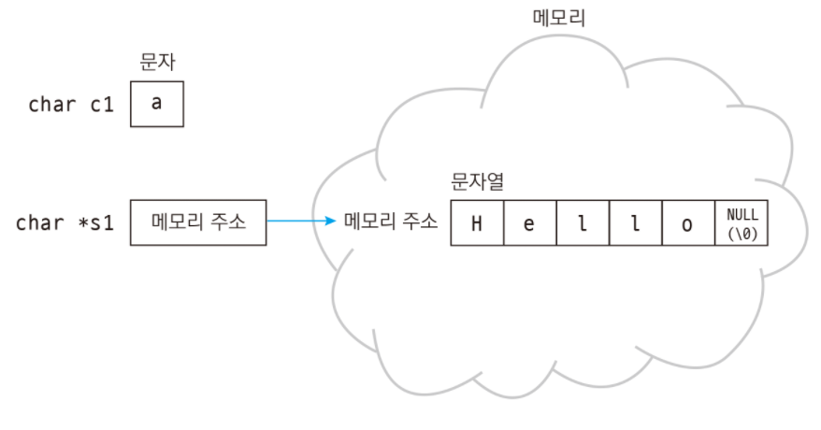
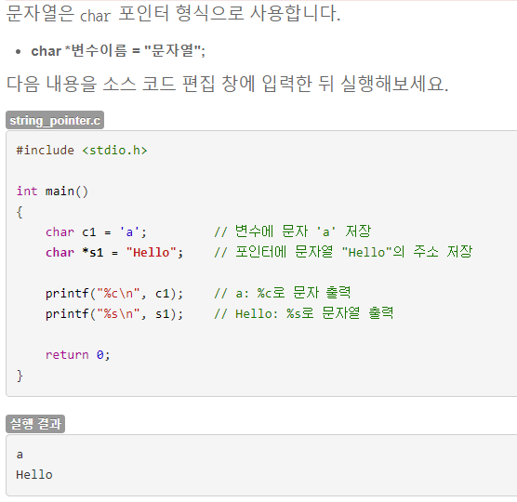
Pointer

Slide 5
Pointer

Slide 6
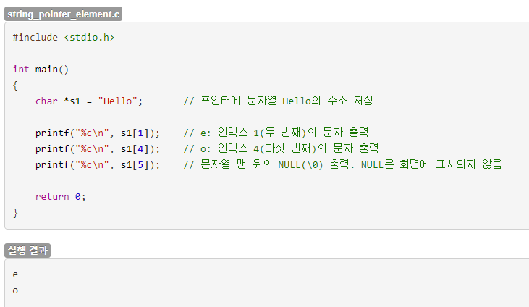
Pointer

Slide 7
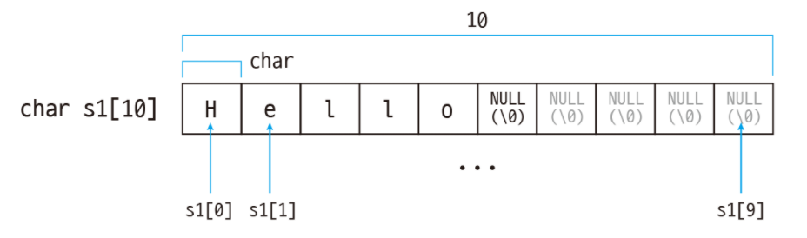
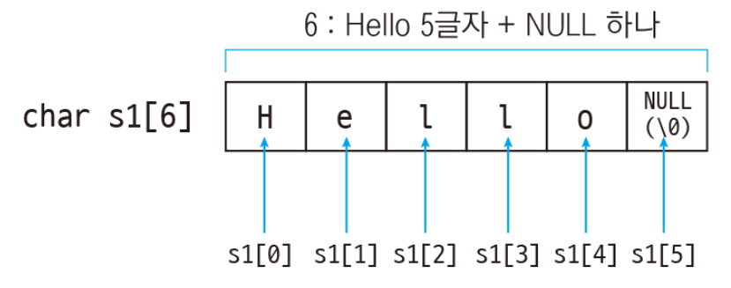
Pointer

Slide 8
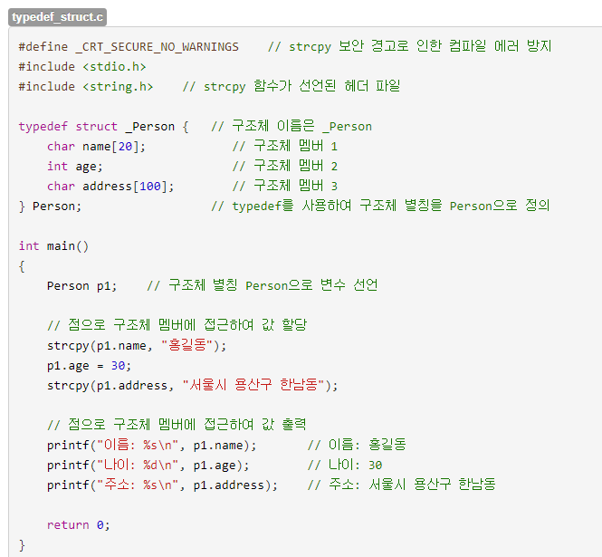

Structure

Slide 9
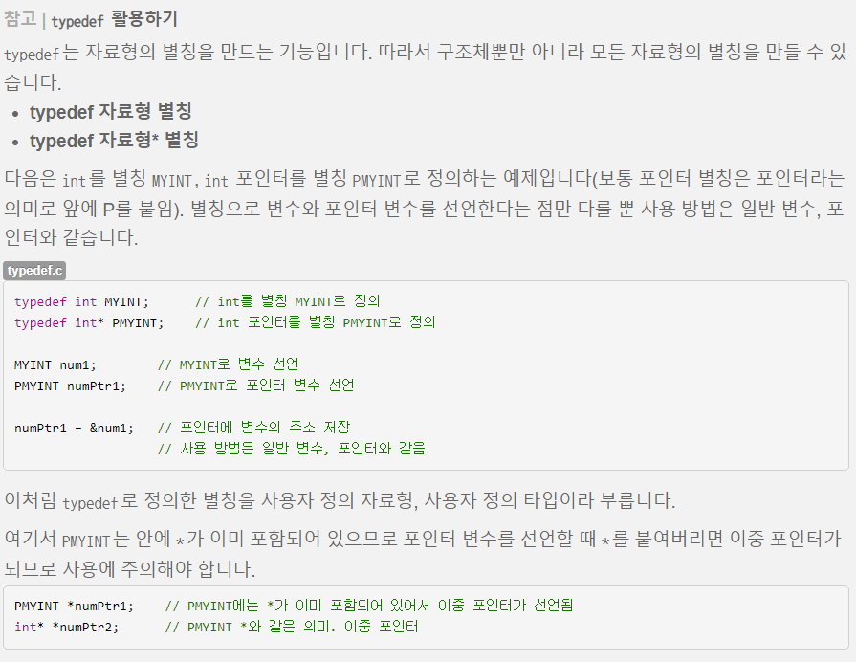
Structure

